Slide 1
BASICS of Subversion
By
Manoj Rajagopal

Slide 2
AGENDA
Subversion - Introduction
Terminologies
SVN Operations Using GUI(Tortoise SVN)
SVN in Eclipse
SVN in Jenkins
SVN Operations Using Command-Line
Assignments

Slide 3

Versioning
Versioning is a process where the state of a project at a point in time is saved.
Often used to manage software development, so that work can continue to improve the project or add features, while being able to track what has changed from the last overall “save” point

Slide 4
Version Control Systems
Version Control System (VCS) is a software that helps software developers to work together and maintain a complete history of their work.
Following are the goals of a Version Control System.
Allow developers to work simultaneously.
Do not overwrite each other’s changes.
Maintain history of every version of everything.
A VCS is divided into two categories.
Centralized Version Control System (CVCS) - Subversion
Distributed/Decentralized Version Control System (DVCS) - Git

Slide 5

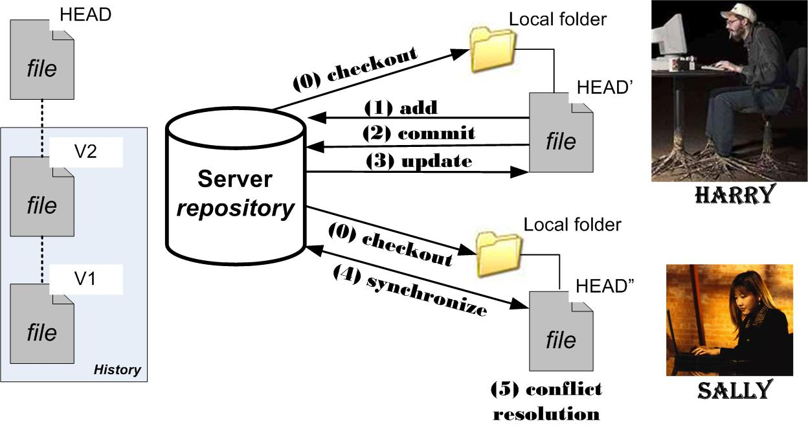
Subversion is a free/open source version control system (VCS)
Subversion manages files and directories, and the changes made to them, over time
This allows you to recover older versions of your data or examine the history of how your data changed
It is centralized server

Slide 6
TERMINOLOGIES
Repository: A repository is the heart of any version control system. It is the central place where developers store all their work. Repository not only stores files but also the history. Repository is accessed over a network, acting as a server and version control tool acting as a client. Clients can connect to the repository, and then they can store/retrieve their changes to/from repository. By storing changes, a client makes these changes available to other people and by retrieving changes, a client takes other people's changes as a working copy.
Trunk: The trunk is a directory where all the main development happens and is usually checked out by developers to work on the project.
Branches: Branch operation is used to create another line of development. It is useful when you want your development process to fork off into two different directions. For example, when you release version 5.0, you might want to create a branch so that development of 6.0 features can be kept separate from 5.0 bug-fixes.
Tags : The tags directory is used to store named snapshots of the project. Tag operation allows to give descriptive and memorable names to specific version in the repository.
For example, LAST_STABLE_CODE_BEFORE_EMAIL_SUPPORT is more memorable than
Repository UUID: 7ceef8cb-3799-40dd-a067-c216ec2e5247 and Revision: 13

Slide 7
Terminologies cont.…..
Working copy: Working copy is a snapshot of the repository. The working copy is a private workplace where developers can do their work remaining isolated from the rest of the team.
Commit : Commit is a process of storing changes from private workplace to central server. After commit, changes are made available to all the team. Other developers can retrieve these changes by updating their working copy.
Checkout : 'Checkout' operation is used to create a working copy from the repository
Update : This operation synchronizes the working copy with the repository. As repository is shared by all the teams other developers can commit their changes and your working copy becomes older.
Merging : Merging refers to the process by which, changed code is blended into one version. It may also entail resolving conflicts.
Revision : When a repository is created, it is given the revision number of zero (0). This number is incremented by one(1) every time a commit is performed. The revision number is global for the repository. That is, that there is no individual revision number for individual files in the repository, even if nothing changed in that file for that specific commit.

Slide 8
DEMO

Slide 9
Questions???

Slide 10
Things To TRY OUT!
Install SVN server and SVN client in your local machine Create SVN repository using svn command line Perform checkout, update and commit with proper messages.
Integrate SVN in Eclipse and perform svn operations
Use Jenkins to checkout and build the sample project
Documentation

Slide 11


